Slide 1

SYBCA – SEM-4
2. jQuery Fundamentals
Web Designing - 2

Slide 2

Introduction to jQuery
What is jQuery?
A lightweight JavaScript library
HTML/DOM manipulation
CSS manipulation
HTML event methods
Effects and animations
AJAX
Utilities
Advantages of jQuery
Easy to learn and use
Cross-browser compatibility
Ajax support
Extensibility
Simplifies DOM manipulation and event handling

Slide 3
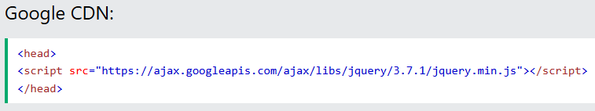

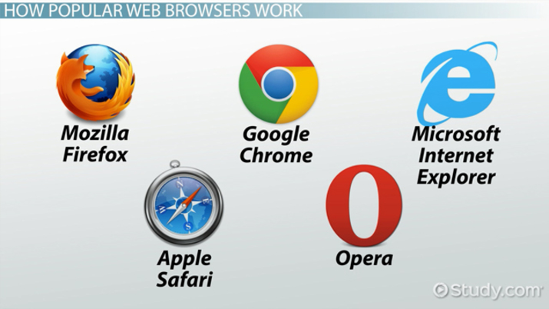
jQuery Installation
Include the library directly from a CDN (Content Delivery Network)
Download and host the library on your own server

